Slide 1
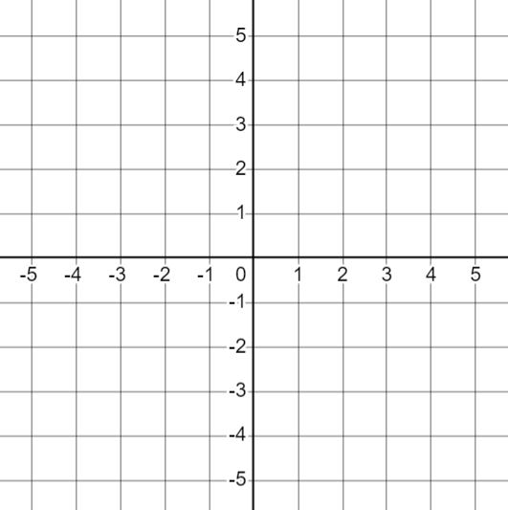

The equation of a straight line
Task A: Different forms of linear relationships
1) Plot each equation and identify the gradient and y-intercept.
x + y = 5 | b) y = 2x − 5 | c) y = 5 − 2x | d) 2x + 2y = 10
gradient =
y-intercept =
gradient =
y-intercept =
gradient =
y-intercept =
gradient =
y-intercept =
2) Match up any equations that represent the same relationship
3) Plot each equation and identify the gradient and y-intercept.
x + y = 4 | b) y = 4 − x | c) y = x + 2 | d) 2y + x = 4
gradient =
y-intercept =
gradient =
y-intercept =
gradient =
y-intercept =
gradient =
y-intercept =
4) Match up any equations that represent the same relationship

Slide 2
The equation of a straight line
Task B: Gradient and y-intercept from y = mx + c
1) Fill in the table with the gradient and y-intercept for each equation.
Write the y-intercept as a coordinate.
equation | gradient | y-intercept
a) y = 8x + 4
b) y = 3x − 7
c) y = −5x + 1
d) y = 10 − 3x
e) y = x
f) y = −x
g) y = 5
h) y = p + (q + 3)x
2) Fill in the missing pieces of information for each question.
equation | gradient | y-intercept
a) y = x + 4 | 9 | (0, )
b) y = − 6x | . | ( , )
c) y = 3(4x + 2) | . | ( , )
d) y = 10 . | −1 | (0, )
e) 5(1 − 2x) = y | . | ( , )
f) 8 − x = y | −5 | (0, )
g) y = + x | t | (0,u)
Mathematics in Education and Industry
v2.2

